Slide 1
The Corporate Transparency Act – Are You Ready? Brian North, Steve Smith, Jared Johnson, and Jennifer Rodriguez
November 2, 2023

Slide 2
The CTA marks a seismic shift in the legal landscape for businesses operating in the United States.
“
– Quote Author Goes Here
”
-- American Bar Association

Slide 3
Today’s Agenda
First item on our agenda
Second item on our agenda
Third item on our agenda
Fourth item on our agenda
Fifth item on our agenda
Background
Key Dates
Reporting Companies
Contents of BOI Reports
Filing Process
Who Are Beneficial Owners?
Who is a Company Applicant?
Obligations to Update BOI Reports
Penalties for Violations
Access to Information
Possible Variables
What You Should be Doing Now
Questions

Slide 4
Background

Slide 5
[T]he relative ease with which U.S. corporations can be established, their opaqueness and their perceived global credibility make them attractive to abuse for [money laundering and terrorism financing], domestically as well as internationally.
– Quote Author Goes Here
“
”
Anti-Money Laundering and Counter-Terrorist Financing Measures, United States Mutual Evaluation Report, Financial Action Task Force
“
The lack of information on who controls shell companies is a glaring hole in our system.
”
Then Secretary of the Treasury Steven T. Mnuchin

Slide 6
Background
CTA enacted as part of the Anti-Money Laundering Act of 2020
Establishes beneficial ownership reporting requirements for entities created in or registered to do business in the United States
Administered by the Financial Crimes Enforcement Network (FinCEN), a bureau of the U.S. Department of Treasury charged with safeguarding the financial system from illicit use, combatting money laundering, and promoting national security
FinCEN adopted final reporting rules on September 30, 2022
Effective date is January 1, 2024

Slide 7
Background
The final reporting rules give rise to a variety of interpretive questions
While FinCEN indicated it would provide guidance and educational outreach, its efforts have been modest to date
Rulemaking still pending:
Final reporting form
Rules for access to reported beneficial ownership information
Extension of filing period for companies formed during 2024

Slide 8
Key Dates

Slide 9
Key Dates
January 1, 2024
A Reporting Company created or registered on or after January 1, 2024 must file an initial beneficial ownership information (BOI) report within 30 days after receiving notice it has been formed or registered
For companies created or registered during 2024 only, there is a pending proposal to extend the filing deadline to 90 days
January 1, 2025
A Reporting Company created or registered before January 1, 2024 must file an initial beneficial ownership information report before January 1, 2025

Slide 10
Reporting Companies

Slide 11
Who Must File Beneficial Ownership Information (BOI) Reports?
Unless exempt, all domestic Reporting Companies and foreign Reporting Companies must file beneficial ownership information reports

Slide 12
Domestic Reporting Company
A corporation, a limited liability company, or other entity that is created by the filing of a document with a secretary of state or any similar office under the law of a state or Indian tribe
A sole proprietorship, trust (other than a statutory business trust), or general partnership generally would not be a Reporting Company since it is not created by a governmental filing

Slide 13
Foreign Reporting Company
A corporation, limited liability company, or other entity that is formed under the law of a foreign country and that is registered to do business in the United States by the filing of a document with a secretary of state or equivalent office under the law of a state or Indian tribe.

Slide 14
Exemptions
The first step in determining whether the reporting requirements apply is to determine whether an entity is exempt
The Act and FinCEN’s regulations exempt 23 specific types of entities from the obligation to file
Many of these are already subject to substantial federal and/or state regulation or are already required to provide their beneficial ownership information to a governmental authority

Slide 15
Exemption – Large Operating Company
An entity that:
Employs more than 20 full-time employees in the United States
Regularly conducts its business at a physical location in the United States that it owns or leases and that is physically distinct from the place of business of any other unaffiliated entity
Has filed a Federal income tax or information return in the United States for the previous year demonstrating more than $5,000,000 in gross receipts or sales, excluding gross receipts or sales from sources outside the United States

Slide 16
Exemption – Publicly Traded Company
An issuer of securities that:
Has a class of securities registered under Section 12 of the Securities Exchange Act of 1934; or
Is required to file supplementary and periodic information under Section 15(d) of the Securities Exchange Act of 1934

Slide 17
Exemption – Tax-Exempt Entity
An entity that is:
An organization described in Section 501(c) of the Internal Revenue Code of 1986 (Code) (determined without regard to Section 508(a) of the Code) and exempt from tax under Section 501(a) of the Code
A political organization, as defined in Section 527(e)(1) of the Code, that is exempt from tax under Section 527(a) of the Code; or
Certain charitable trusts and split interest trusts described in paragraph (1) or (2) of Section 4947(a) of the Code.

Slide 18
Exemption – Pooled Investment Vehicle
A domestic fund that meets the following requirements:
It is (1) an investment company registered under the Investment Company Act of 1940 or (2) exempt from registration under Section 3(c)(1) or Section 3(c)(7) of the Investment Company Act and is named in the Form ADV filed by its investment adviser with the SEC; and
Is advised or operated by a bank, credit union, broker-dealer, registered investment adviser, registered investment adviser, or venture capital fund adviser
A foreign fund that would qualify for this exemption will nonetheless be a Reporting Company, but has a reduced reporting requirement

Slide 19
Exemption – Wholly Owned Subsidiary of an Exempt Entity
An entity whose ownership interests are controlled or wholly owned, directly or indirectly, by one or more exempt entities other than a subsidiary of:
an exempt money services business;
an exempt inactive entity; or
an exempt entity assisting a tax-exempt entity.

Slide 20
Exemption – Inactive Entity
An entity that:
Was in existence on or before January 1, 2020;
Is not engaged in active business;
Is not owned by a foreign person, whether directly or indirectly, wholly or partially;
Has not experienced any change in ownership in the preceding 12 months;
Has not sent or received any funds in an amount greater than $1,000, either directly or through any financial account in which the entity or any affiliate of the entity had an interest, in the preceding 12 months; and
Does not otherwise hold any kind or type of assets, whether in the United States or abroad, including any ownership interest in any corporation, limited liability company, or other similar entity.

Slide 21
Exemption – Regulated Entities
Governmental Authorities
Banks
Credit Unions
Bank or Savings and Loan Holding Companies
Money Services Businesses
Registered Broker-Dealers
Securities Exchanges and Clearing Agencies
Other Entities Registered with the SEC under the Securities Act of 1934
Registered Investment Companies and Investment Advisers
Certain Venture Capital Fund Advisers
Insurance Companies
State-Licensed Insurance Producers
Certain Commodity Exchange Act Registered Entities
Public Utilities
PCAOB Registered Accounting Firms
Financial Market Utilities
Pooled Investment Vehicles Operated or Advised by a Bank, Credit Union, Registered Investment Company, Registered Investment Adviser, or Certain Venture Capital Fund Advisers

Slide 22
Exemption - Takeaways
The first step in determining whether the CTA reporting requirements apply is to review the available exemptions
FinCEN’s website has published a useful checklist of the available exemptions in its Small United States Entity Compliance Guide, available at
https://www.fincen.gov/sites/default/files/shared/BOI_Small_Compliance_Guide_FINAL_Sept_508C.pdf
Caution! Reporting requirements can apply to large companies, such as
Private funds not advised by a registered investment adviser
A joint venture if profit interests are awarded to employees

Slide 23
Contents of BOI Reports

Slide 24
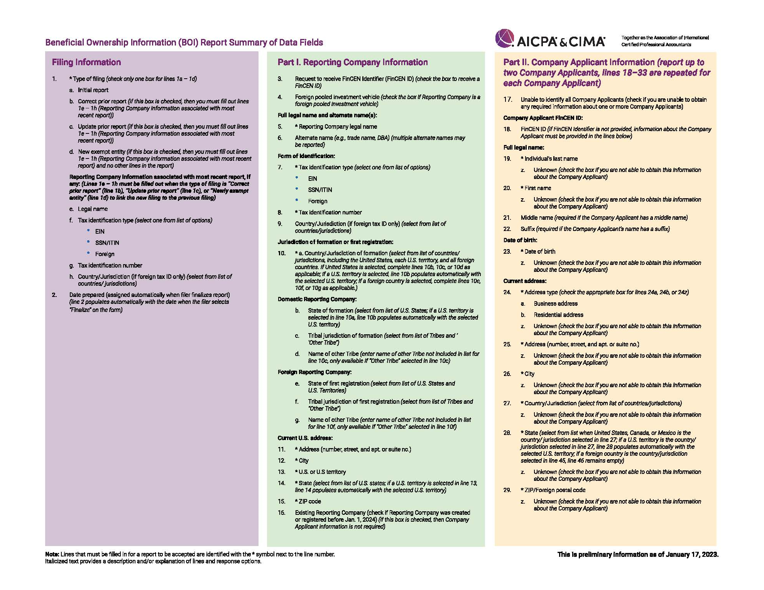

Slide 25
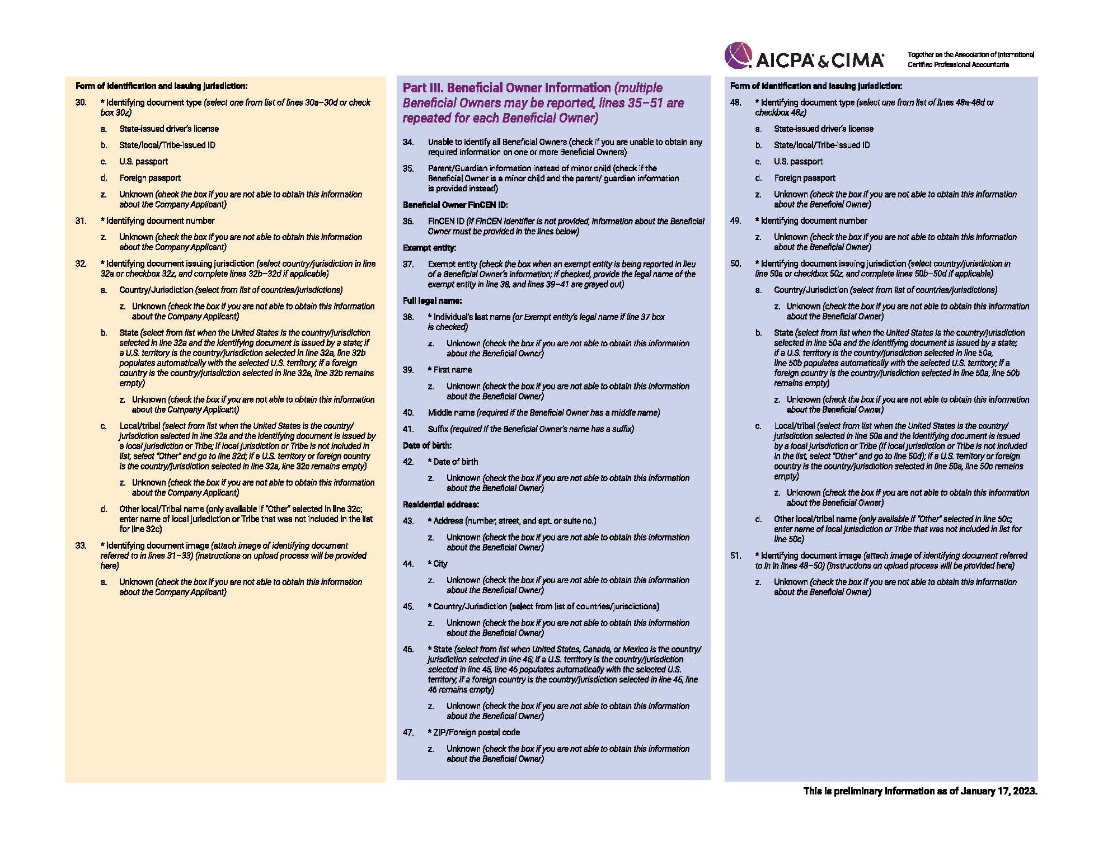

Slide 26
Contents of Report – Reporting Company
Full legal name and any fictitious name (dba);
Street address of principal place of business or, for Foreign Reporting Company, primary location in United States;
Jurisdiction of formation;
For a Foreign Reporting Company, the State or Tribal jurisdiction where such company first registered; and
IRS Taxpayer Identification Number (TIN) (including an Employer Identification Number (EIN)) or where a Foreign Reporting Company has not been issued a TIN, a tax identification number issued by a foreign jurisdiction and the name of such jurisdiction.

Slide 27
Contents of Report - Beneficial Owners
Full legal name;
Date of birth;
Residential street address;
A unique identifying number and the issuing jurisdiction from certain government-issued IDs (US passport, State ID, driver’s license, foreign government passport); and
An image of the document from which the unique identifying number was obtained.

Slide 28
Unknown Beneficial Owner Information
“Unknown” checkboxes
Perceived as optional
Proposed drop-down boxes (NRPM September 30, 2023) “(but not limited to), “Cannot Contact BO”; “BO Unresponsive”; “BO Refused to Provide”; and “Third Party Refused to Provide.”
Collects information on filing difficulties
“[d]rop-down options will not be included in the other sections of the form (e.g., Reporting Company Section and Company Applicant(s) Section).”

Slide 29
Contents of Report – Company Applicants
Only required for entities created on or after January 1, 2024
The same information that is required for beneficial owners, except a company applicant who forms or registers an entity in the course of such company applicant's business, in which case the street address of such business must be reported.

Slide 30
Contents of Report – FinCEN Identifier
A beneficial owner or company applicant can obtain from FinCEN a FinCEN identifier which the Reporting Company can include in its report instead of the specific identifying information required in a report.
A Reporting Company may also obtain a FinCEN identifier by submitting to FinCEN an application at or after the time that the entity submits an initial report.
Third-Party Providers
“Third-party service providers will have the ability to submit the reports via FinCEN’s e-Filing system and/or an Application Programming Interface (API). Technical specifications for the API will be made available at a later date.” (FAQ N.1.)

Slide 31
Contents of Report – Certification
The Reporting Company must certify that the information provided is “true, correct, and complete.”
This certification requires the Reporting Company to certify the accuracy of information provided to it by third parties.
“FinCEN believes that it is reasonable to require reporting companies to certify the accuracy and completeness of their own reports, and it is appropriate to expect that reporting companies will take care to verify the information they receive from their beneficial owners and applicants before they report it to FinCEN.”

Slide 32
Filing Process

Slide 33
Practical Impact
32.6 million = The number of filings estimated for 2024
5-6 million = Filings for each year thereafter
32,800,422 = Hour burden for entities to complete the filing in the first year
Not including:
Determinations of “beneficial owner,” “substantial control,” “applicant,” or “reporting company”
Monthly tracking to anticipate changes that require updating within the 30-day reporting timeframe
Added mental stress of ensuring regular monitoring
Working under the threat of criminal prosecution

Slide 34
Beneficial Owner Secure System (BOSS)
Online interface
Portal
Separate from existing Bank Security Act (BSA) platform
Fillable .pdf
Batch filing
Leveraged existing BSA components, but it has required extensive architecture and engineering
Protection of information – Federal Information Security Management Act

Slide 35
Privilege
“When information is transmitted to an attorney with the intent that the information will be transmitted to a third party (in this case on a tax return), such information is not confidential.” United States v. Frederick, 182 F.3d 496 (7th Cir. 1999)
“[C]ourts have refused to apply the privilege to information that the client intends his attorney to impart to others.” United States v. Pipkins, 528 F.2d 559, 563 (5th Cir. 1976). The same is true of the communications between the client and the attorney about the return being prepared. Id.
“[I]f a taxpayer turns over pre-existing records to an attorney, the Service can obtain those records by summons, unless the records were otherwise privileged from production while in the taxpayer’s possession. United States v. Davis, 636 F.2d 1028, 1041 (5th Cir. 1981); United States v. Bartlett, 449 F.2d 700, 703 (8th Cir. 1971).

Slide 36
Who are Beneficial Owners?

Slide 37
Beneficial Owners
A “Beneficial Owner” of a Reporting Company is any individual who, directly or indirectly, either:
exercises substantial control over the Reporting Company; or
owns or controls at least 25 percent of the ownership interests of the Reporting Company
Note: Unlike the definition of control in other areas of the law, the use of control in this definition of “Beneficial Owner” requires the actual exercise of control; not just possession of the power to control

Slide 38
Beneficial Owner – Substantial Control
A senior officer of the Reporting Company;
A person with authority to appoint or remove a senior officer or a majority of the board of directors (or similar body);
A person who directs, determines, or has substantial influence over “important decisions” made by the Reporting Company; or
A person who has any other form of substantial control over the Reporting Company

Slide 39
Beneficial Owner – Substantial Control
The “important decisions” that could result in having substantial control include directing, determining, or having substantial influence over:
The nature, scope, and attributes of the Reporting Company’s business
Reorganization, dissolution, or merger
The selection or termination of business lines or ventures, or geographic focus
Compensation schemes and incentive programs for senior officers
Entry into or termination, or the fulfillment or non-fulfillment, of significant contracts
Amendments of substantial governance documents

Slide 40
Beneficial Owner – Substantial Control
Substantial control may be exercised over a Reporting Company through:
Board representation;
Ownership or control of a majority of the voting power;
Rights associated with any financing arrangement or interest;
Control over one or more intermediary entities that separately or collectively exercise substantial control over a Reporting Company;
Arrangements or financial or business relationships, whether formal or informal, with other individuals or entities acting as nominees; or
Any other contract, arrangement, understanding, or relationship.

Slide 41
Beneficial Owners – Ownership Interests
Any equity, stock, or similar instrument or right to acquire such ownership interest, without regard to whether any such instrument is transferable, is classified as stock or anything similar, or confers voting power or voting rights
Any capital or profit interest in an entity
Convertible interests and futures on convertible interests
Warrants and rights to purchase or sell shares or interests
Options to purchase or sell
Any other instrument, contract, arrangement, understanding, relationship, or mechanism used to establish ownership

Slide 42
Beneficial Ownership – Ownership Interests
Ownership includes:
Joint ownership of an undivided interest
Ownership through another individual acting as a nominee, intermediary, custodian, or agent
For a trust holding an ownership interest,
A trustee who can dispose of the trust assets
A beneficiary who is the sole permissible recipient of income and principal or who can withdraw substantially all of the trust assets
A grantor who has the right to revoke the trust or withdraw all of its assets
Ownership of intermediary entities that own or control ownership interests in a Reporting Company

Slide 43
Beneficial Ownership – Ownership Interests
In calculating a person’s percentage ownership interests, all options and similar interests are treated as exercised
The percentage ownership of capital or profits interests is calculated as a percentage of the total outstanding capital and profit interests of the entity
For corporations, entities treated as corporations for federal income tax purposes, and other reporting companies that issue shares of stock, percentage ownership is the greater of:
(1) the percentage of the total outstanding voting power of all classes of ownership interests entitled to vote, or
(2) the percentage of the total outstanding value of all classes of ownership interests
If it is difficult to calculate the percentage ownership interest, look to the percentage owned or controlled of any class or type of interest of a Reporting Company

Slide 44
Beneficial Ownership - Exceptions
A minor child if the Reporting Company reports the required information for a parent or guardian
A nominee, intermediary, custodian, or agent acting on behalf of another individual
An employee of a Reporting Company, acting solely as an employee, whose substantial control over or economic benefits from such entity are derived solely from the employment status of the employee, provided that such person is not a senior officer
An individual whose only interest in a Reporting Company is a future interest through a right of inheritance
A creditor whose sole interest is based on the right to receive the repayment of money or an associated loan covenant or other right intended to secure repayment.

Slide 45
Who is a Company Applicant?

Slide 46
Company Applicant
For a domestic Reporting Company, the individual who directly files the document that creates the domestic Reporting Company
For a foreign Reporting Company, the individual who directly files the document that registers the foreign Reporting Company
The individual who is primarily responsible for directing or controlling such filing, if more than one person is involved with the filing
No more than two Company Applicants for any Reporting Company

Slide 47
Company Applicant
Final reporting rule clarifications and examples:
State filing office employees
Commercial business formation services
Law firm staff
Self filing
Need for final rule clarifications and examples of how the requirements apply

Slide 48
Obligation to Update BOI Reports

Slide 49
Updated BOI Reports
If there is a change in the information reported for any Reporting Company or beneficial owner or a change in who is a beneficial owner, an updated report must be filed within 30 calendar days of the change
Updated reports are also required if:
a Reporting Company becomes eligible for an exemption from the filing requirements after its initial report is filed;
If an individual is a beneficial owner of a Reporting Company by virtue of property interests or other rights subject to transfer upon death, and such individual dies; or
If a Reporting Company has reported the parent or guardian of a minor as a beneficial owner and the minor reaches majority
Newly exempt entities

Slide 50
Corrected BOI Reports
If a BOI report was inaccurate when filed and remains inaccurate, the Reporting Company must file a corrected report within 30 calendar days after the date the Reporting Company becomes aware or has reason to know of the inaccuracy.
If a corrected BOI report is filed within 90 days after the initial inaccurate report was filed, a Reporting Company will be entitled to the benefit of a safe harbor from the penalties under the Corporate Transparency Act for willfully providing false or fraudulent information.

Slide 51
Penalties for Violation

Slide 52
Penalties
There are civil and criminal penalties under the Act for:
Willfully providing, or attempting to provide, false or fraudulent beneficial ownership information to FinCEN; or
Willfully failing to provide complete or updated beneficial ownership information to FinCEN
Under FinCEN’s rule, a person provides or attempts to provide information to FinCEN for purposes of determining a violation if he or she provides information to another person for purposes of a report or application under the rule.
Also under FinCEN’s rule, a person fails to report complete or updated beneficial ownership information to FinCEN if the person caused the Reporting Company’s failure to report or is a senior officer of the Reporting Company that failed to report.

Slide 53
Penalties
Civil penalty of $500 per violation per day for each day the violation continues or is not remedied, up to $10,000
Criminal fine of up to $10,000, imprisonment for up to 2 years or both
Definition of “willful” is to be determined
“Evasion of the reporting requirements”
“Actual knowledge of inaccuracies”

Slide 54
Penalties – Misuse and Unauthorized Disclosure
The Act also provides civil and criminal penalties for the misuse or unauthorized disclosure of beneficial ownership information reported to FinCEN or provided by FinCEN to certain authorized parties under the Act.
Civil penalty of up to $500 per day for each day the violation continues or has not been remedied.
Criminal penalty of up to $250,000 or up to five years in prison, or both.
If the violation occurs while violating another law of the United States or as part of a pattern of any illegal activity involving more than $100,000 in a 12-month period, fine goes up to $500,000 and the imprisonment is up to ten years, or both.

Slide 55
Safe Harbor
There is a safe harbor from civil and criminal penalties under the Act for reporting inaccurate information if it is determined after a BOI report is filed that it contained inaccurate information and a corrected report is filed with FinCEN within 90 days after the date of the initial inaccurate report.
This safe harbor is not available if a person:
Acted for the purpose of evading the reporting requirements
Had actual knowledge that the information was inaccurate

Slide 56
Access to Information

Slide 57
Access to Information
As required by the Act, FinCEN has proposed regulations to address who has access to the beneficial ownership information reported to it:
Federal agencies for national security, intelligence, or law enforcement activity;
State, local, and Tribal law enforcement agencies for use in criminal or civil investigations, if a court has authorized the agency to seek the information;
Federal agencies on behalf of a law enforcement agency, prosecutor, or judge of another country, or on behalf of a foreign central authority or foreign competent authority (or like designation) that need it for a law enforcement investigation or prosecution, or for a national security or intelligence activity;
Financial institutions for customer due diligence, if consented to by a Reporting Company;
Financial institution regulator agency to determine compliance with a financial institution’s customer due diligence obligations; and
Department of Treasury officers or employees

Slide 58
Interagency versus Intradepartmental Access
170 words = Disclosure to Federal agencies for use in furtherance of national security, intelligence, or law enforcement activity. (“Upon receipt of a request…FinCEN may disclose”)
144 words = Disclosure to State, local, and Tribal law enforcement agencies for use in criminal or civil investigations. (“Upon receipt of a request…FinCEN may disclose”)
167 words = Disclosure for use in furtherance of foreign national security, intelligence, or law enforcement activity. (“Upon receipt of a request…FinCEN may disclose”)
206 words = Disclosure to facilitate compliance with customer due diligence requirements – Financial Institutions and Regulatory Agencies. (“Upon receipt of a request…FinCEN may disclose”)
80 words (2 sentences) = Department of the Treasury. (“Information reported pursuant to § 1010.380 shall be accessible for inspection or disclosure to officers and employees of the Department of the Treasury whose official duties the Secretary determines require such inspection or disclosure. Officers and employees of the Department of the Treasury may obtain information reported pursuant to § 1010.380 for tax administration as defined in 26 U.S.C. 6103(b)(4).”)

Slide 59
Use of Information
Use of the information is limited to the purpose for which it was disclosed
Before receiving information, a domestic agency must enter into an agreement with FinCEN specifying the standards, procedures, and systems to be maintained by the agency, and any other requirements FinCEN may specify, to protect the security and confidentiality of such information
A domestic agency must provide a report describing its standards and procedures for handling the information and certify that they meet the requirements of FinCEN’s rule

Slide 60
Further Developments
Form 8300 e-filing requirement
IRS auditor hirings
DIF and UIDIF score evolutions
Social media algorithms
Usage of GIINs

Slide 61
Possible Variables

Slide 62
Possible Variables
Executive
FinCEN preparation and clarification
Legislative
Protecting Small Business Information Act of 2024 — H.R. 4035 and S. 2623
Committee hearings
Judicial
National Small Business United v. Yellen, (5:22-cv-01448) N.D. Alabama

Slide 63
What You Should be Doing Now

Slide 64
What You Should be Doing Now
Become aware of the available Reporting Company exemptions and the definitions of Beneficial Owner and Company Applicant now in preparation for forming or registering new Reporting Companies on and after January 1, 2024
Determine whether your existing entities are subject to the reporting requirements or are exempt. If not exempt, determine who the Beneficial Owners are
Create a process to gather the required information (and future changes in that information) to permit filing initial reports and updated reports, if required
Determine how the reports will be filed with FinCEN, if required

Slide 65
CLE CREDIT INFORMATION CLE KEYWORD: CTA To obtain your CLE credit, please complete the post-event survey (it will show on your screen when you leave the webinar) or email the keyword to: Pamela Mannion | pamela.mannion@bipc.com

Slide 66
Questions?

Slide 67
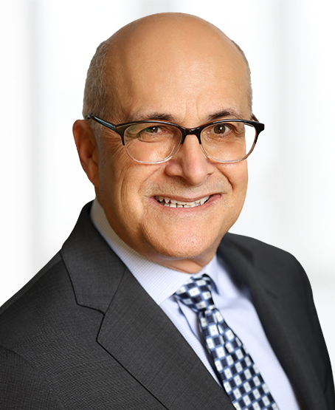
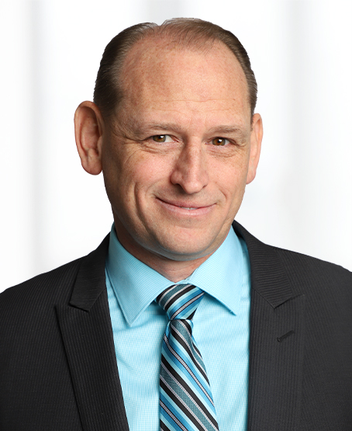
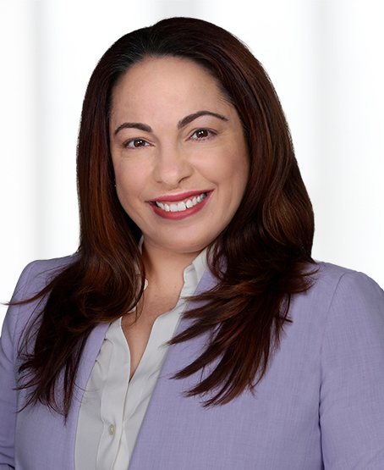
For additional information or for questions, please contact your Buchanan attorney or one of today’s speakers. Thank you.
Brian North
215-665-3828
brian.north@bipc.com
Steve Smith
215-665-3607
steven.smith@bipc.com
Jared Johnson
215-665-5357
jared.johnson@bipc.com
Jennifer Rodriguez
954-468-2334
jennifer.rodriguez@bipc.com

